Slide 1
Bayesian Models for Text Classification
B. Malar
Associate Professor
Dept. of Applied Mathematics and Computational Sciences
PSG COLLEGE OF TECHNOLOGY
Coimbatore
1

Slide 2
Outline
Machine Learning
Naïve Bayes Classification
Theory
Issues
Bayesian Text Classification
Conclusion

Slide 3
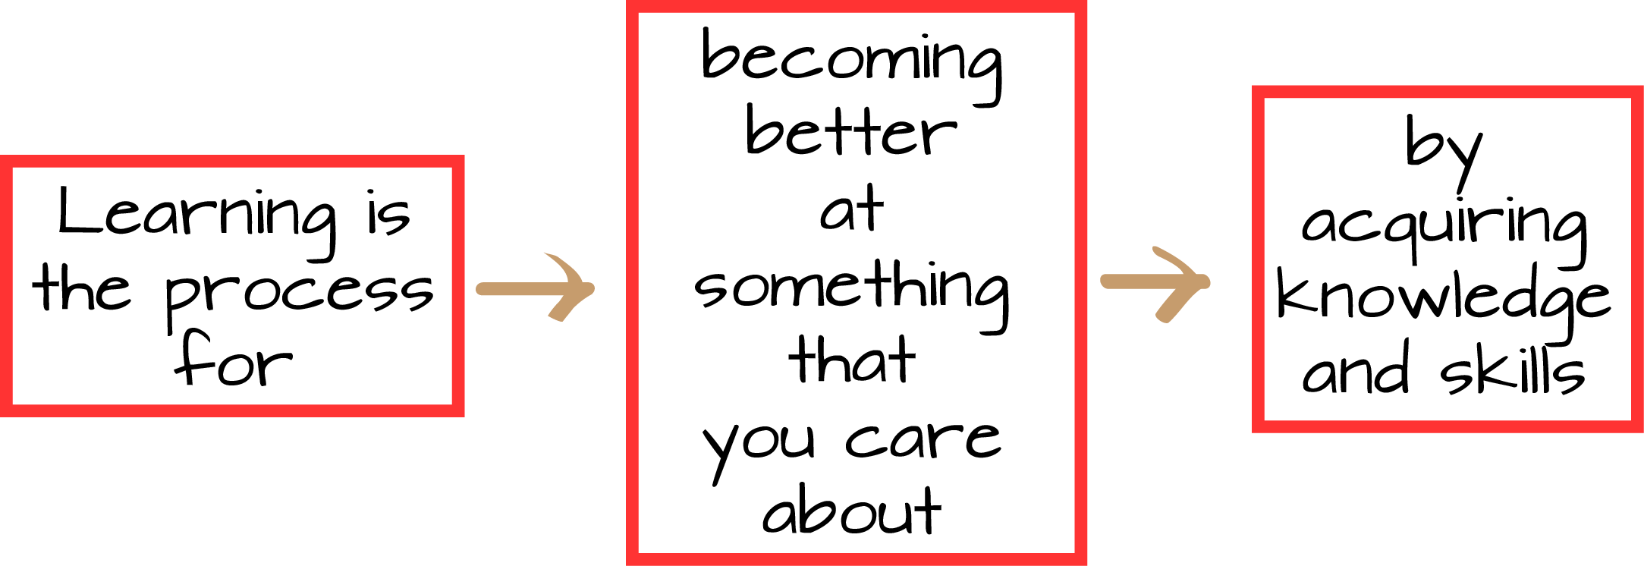
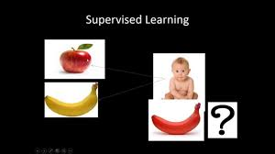
Learning
Notes:
the acquisition of knowledge or skills through study, experience, or being taught.

Slide 4
Machine Learning
Study of algorithms that
  Improve their performance P
  At some task T
  With experience E
Machine learning is programming computers to optimize a performance criterion using example data or past experience.

Slide 5
Machine Learning
Machine Learning (Mitchell 1997)
  Learn from past experiences
  Improve the performances of intelligent programs
Definitions (Mitchell 1997)
  A computer program is said to learn from experience E with respect to some class of tasks T and performance measure P, if its performance at the tasks improves with the experiences

Slide 6
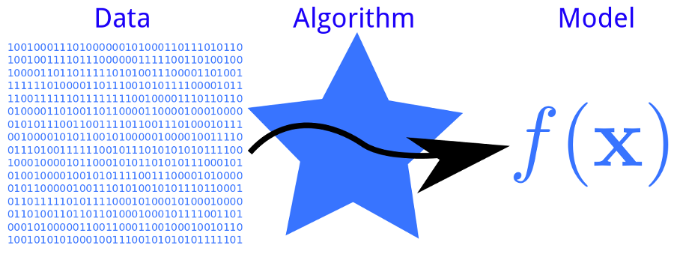
Learning

Slide 7

Deterministic data (Certain data)
Id | X | Y
P1 | 9 | 81
P2 | 1 | 1
P3 | 2 | 4
P4 | 5 | 25
P5 | 8 | 64
P6 | 10 | 100
P7 | 6 | 36
P8 | 3 | 9

Slide 8
Text Classification
Text Classification
  Task T
    Assigning texts to a set of predefined categories
  Performance measure P
    Precision and recall of each category
  Training experiences E
    A database of texts with their corresponding categories

Slide 9
E Mail Classification
Task T – Classifying mails as Spam / Ham
Performance Measure P – Percentage of mails correctly classified
Training Experience E – a database of spam and ham mails

Slide 10
Handwritten Character Recognition
Task T – Recognising and classifying handwritten characters
Performance Measure P – Percentage of characters correctly classified
Training Experience E – a database of handwritten characters with given classification

Slide 11

Handwritten Character Recognition
6132
2056
2014
4283
2064

Slide 12

Cancer diagnosis
Task T – Classifying malignant(cancer) / benign (non cancer) tumors
Performance Measure P – Number of cancer patients correctly diagnosed
Training Experience E – a database of cancer and non-cancer patients

Slide 13
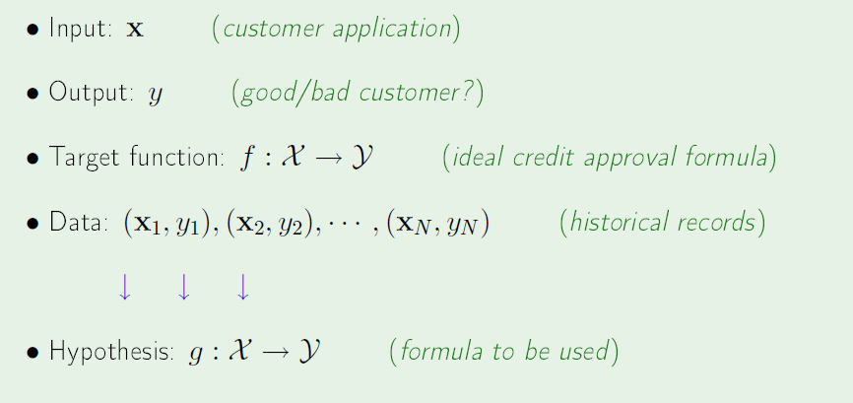
Components of ML

Slide 14
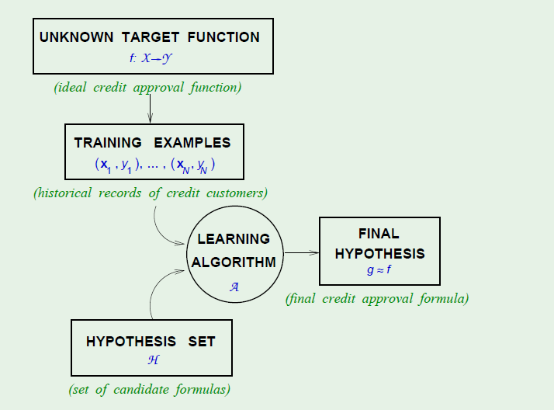
ML in a Nutshell –
Learning a function from data

Slide 15
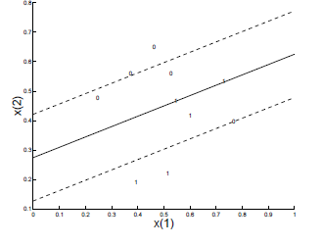
Model – Line (Y = WX+b)

Slide 16
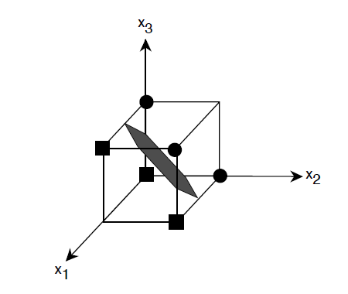
Model – Hyperplane

Slide 17
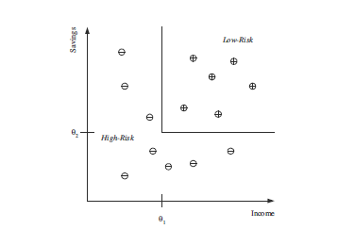
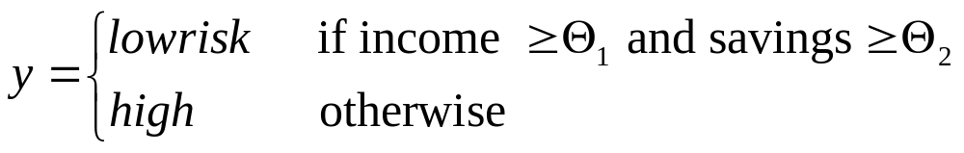
Model – Rule

Slide 18
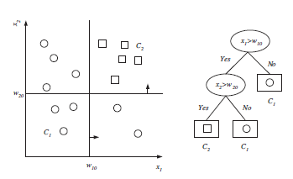
Model - Decision tree

Slide 19
Machine Learning Paradigms
Supervised learning
  Classification
  Regression
Unsupervised Learning
  Clustering
Semi-supervised Learning
  Collective Classification

Slide 20
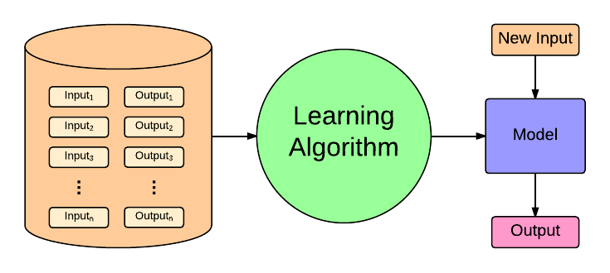
Supervised Learning

Slide 21
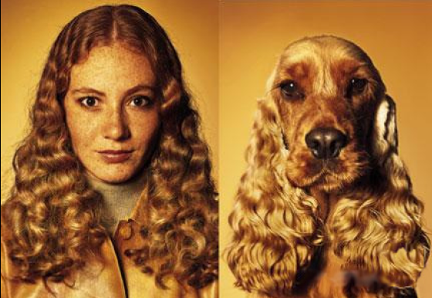
Unsupervised Learning
Grouping a set of given data points into clusters so that data points in the same cluster are similar in some sense

Slide 22
Supervised Learning
Supervised learning
  Classification
  Regression

Slide 23
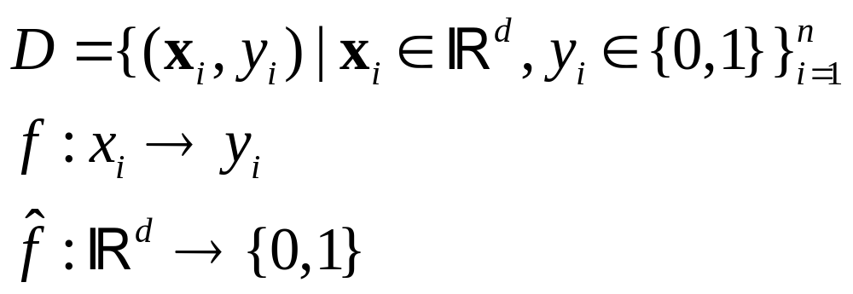
Classification

Slide 24
Supervised Learning
Classification
  Naïve Bayes
  Decision tree
  Support Vector Machine
  K-nearest neighbor
Regression
  Linear
  Polynomial
  Multiple regression

Slide 25
Applications
Medical Diagnosis
  Cancer Diagnosis
  Diabetics
  Heart Attack
Web Spam Classification
Mail spam classification
Classification of Twitter Data

Slide 26
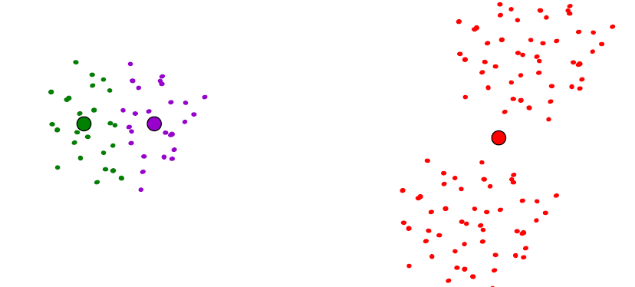
Unsupervised Learning - Clustering

Slide 27
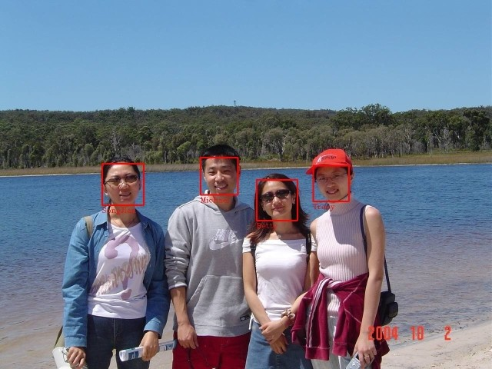
Face detection
discriminating human faces from non faces.

Slide 28
Cancer diagnosis
Input Features
Cell size
Cell shape
Clump thickness
Single epithelial cell size
Bare nuclei
Bland chromatin
Normal nucleoli
mitoses
Output
Malignant
Benign

Slide 29
dataset
Id | Cell Size | Thickness | Class
P1 | 8 | 10 | 1
P2 | 1 | 1 | 0
P3 | 2 | 1 | 0
P4 | 5 | 3 | 1
P5 | 8 | 7 | 1
P6 | 10 | 7 | 1
P7 | 6 | 1 | 0
P8 | 3 | 1 | 0

Slide 30
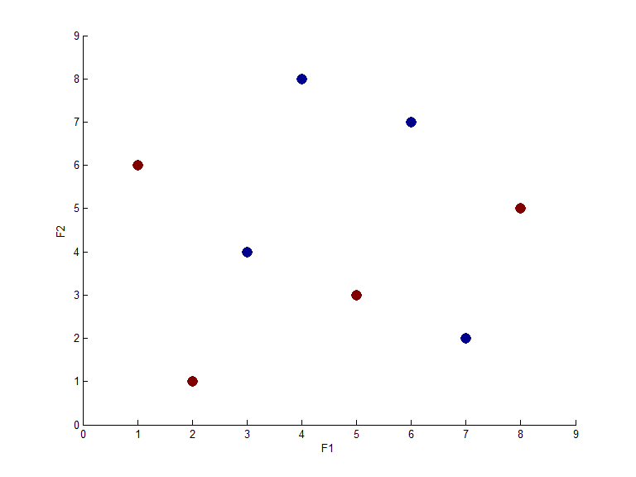
Graphical Representation

Slide 31
Naïve Bayes Classifier

Slide 32
Bayesian Classification
Probabilistic classifier
All features are conditionally independent given the output.
P(X1|X2,y) = P(X1|y)
Example:
  Predicting Apples from Oranges (y = apple/orange)
  Features : (X1, X2, X3) = (Shape, color, taste)
  P(shape, color| apple, taste) = P(shape, color|apple)

Slide 33
Prior Probability
Probability distribution of knowledge or data before observing it.
    P(Y = malignant) = 4/8
    P(Y = benign) = 4/8
Id | C.Size | Thick | Y
1 | 8 | 10 | M
2 | 1 | 1 | B
3 | 2 | 1 | B
4 | 5 | 3 | M
5 | 8 | 7 | M
6 | 10 | 7 | M
7 | 6 | 1 | B
8 | 3 | 1 | B

Slide 34
Joint Probability
Probability of two events occurring together
P(A,B) = n(A,B) / # Experiments
P(Y= benign and Size = B) = 1/8
P(Y=malignant, size = B) = 4/8
Id | Cell Size | Thickness | Y
1 | B | 10 | M
2 | S | 1 | B
3 | S | 1 | B
4 | B | 3 | M
5 | B | 7 | M
6 | B | 7 | M
7 | B | 1 | B
8 | S | 1 | B

Slide 35
Conditional Probability
Likelihood of an event or outcome occurring based on the previous event
P(X|Y) = P(X,Y) / P(Y)
P(Cell size = B|Y = malignant)
= 1
P(X,Y) = P(X|Y)P(Y)
If X and Y are independent
  P(X|Y) =P(X)
P(X,Y) = P(X)P(Y)
Id | C.Size | Thick | Y
1 | B | 10 | M
2 | S | 1 | B
3 | S | 1 | B
4 | B | 3 | M
5 | B | 7 | M
6 | B | 7 | M
7 | B | 1 | B
8 | S | 1 | B

Slide 36
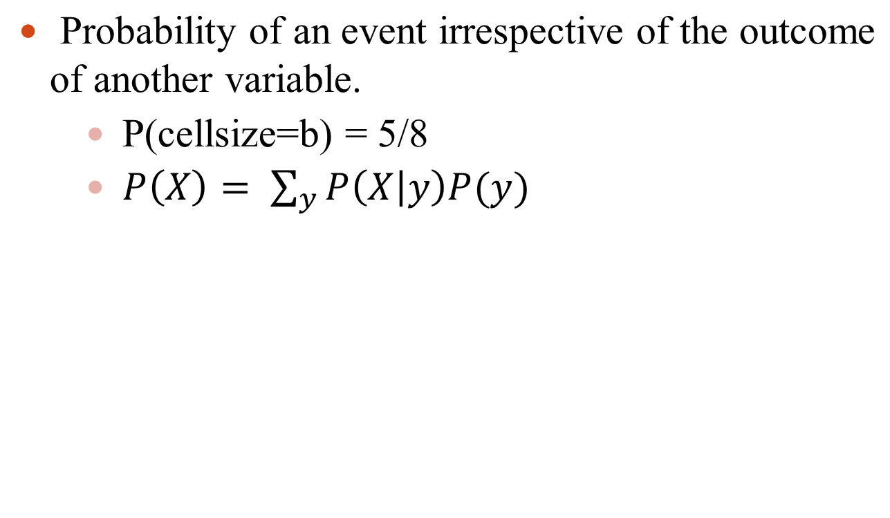
Marginal Probability
Id | C.Size | Thick | Y
1 | B | 10 | M
2 | S | 1 | B
3 | S | 1 | B
4 | B | 3 | M
5 | B | 7 | M
6 | B | 7 | M
7 | B | 1 | B
8 | S | 1 | B

Slide 37
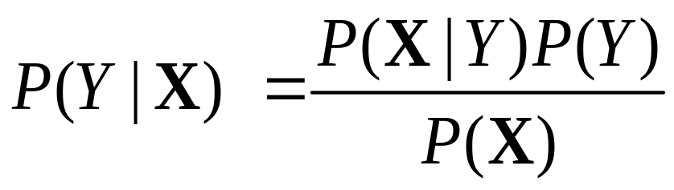
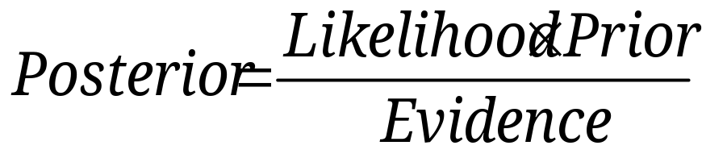
Bayes Theorem
Bayesian Rule

Slide 38
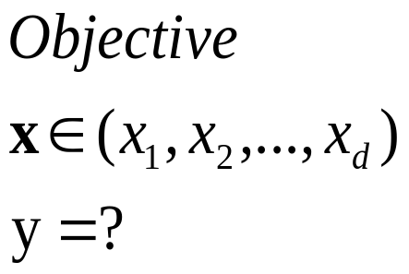
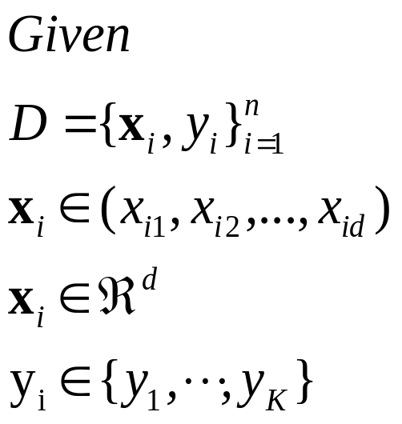
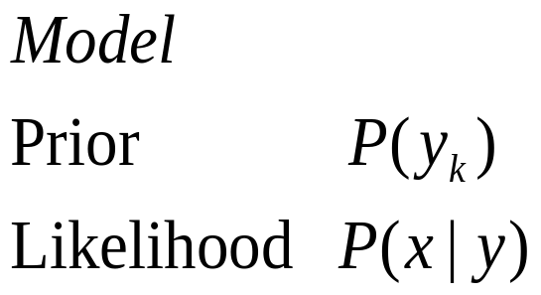
Bayesian Classification
Problem statement:

Slide 39
Assumption
Conditional Independence Assumption
  X is conditionally independent of Y given Z if probability distribution of X is independent of the value of Y given the value of Z
  P(X|Y,Z) = P(X|Z)
  P(Thunder | Lightening, Rain) = P(Thunder| Lightening)
  NB assumes the all features are conditionally independent given the class variable.
  P(x1|x2,x3, … , xd,y) = P(x1|y)

Slide 40

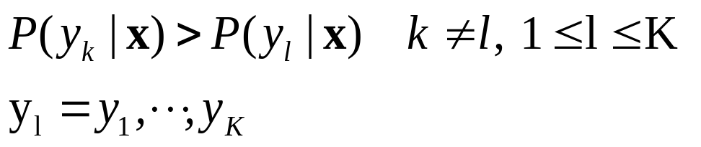
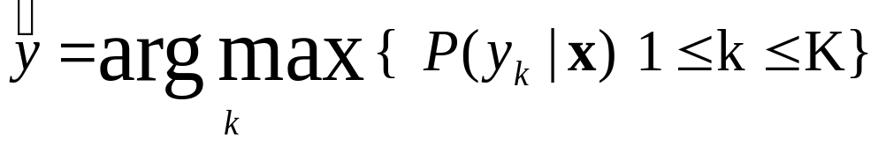
Prediction
MAP classification rule
  MAP: Maximum A Posterior
  Assign x to if

Slide 41
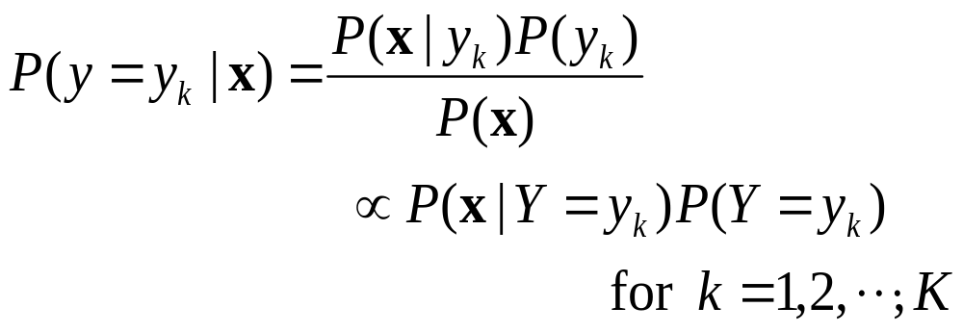
Prediction
Method of Generative classification with the MAP rule
  Apply Bayesian rule to convert them into posterior probabilities
  Then apply the MAP rule

Slide 42
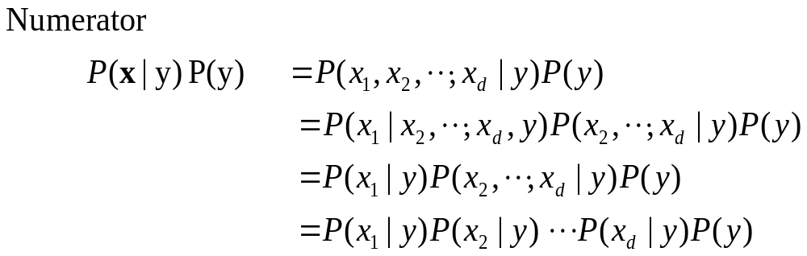

Naïve Bayes
Naïve Bayes classification
  Assumption that all input attributes are conditionally independent!

Slide 43
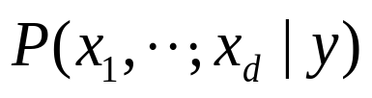
Naïve Bayes
Bayes classification
  Difficulty: learning the joint probability

Slide 44
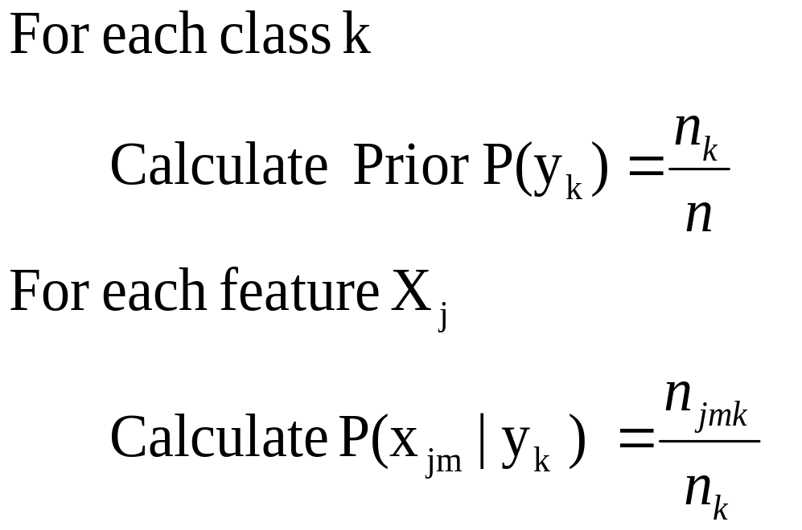
Algorithm
Naïve Bayes Algorithm (for discrete input attributes) has two phases
  Learning Phase:
  Given a training set D,
  Output: conditional probability tables

Slide 45
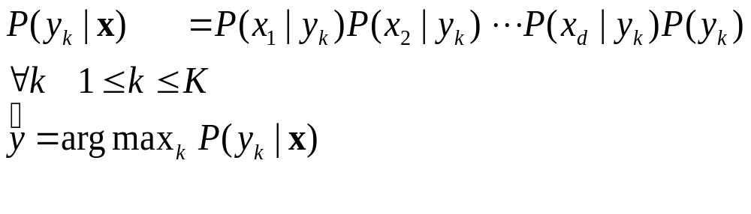

Algorithm
Naïve Bayes Algorithm (for discrete input attributes) has two phases
  2. Test Phase: Given an unknown instance ,
  Look up tables to assign the label to X as follows

Slide 46


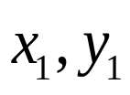
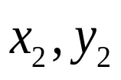

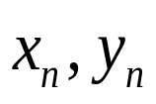
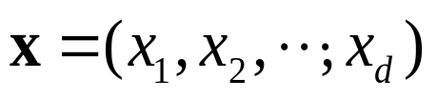
Naïve Bayes
Establishing a probabilistic model for classification
Naïve Bayes Probabilistic Classifier

Slide 47

Naïve Bayes
Establishing a probabilistic model for classification
Naïve Bayes Probabilistic Classifier

Slide 48






Probabilistic Classification
Establishing a probabilistic model for classification (cont.)
Generative
Probabilistic Model
for Class 1
Generative
Probabilistic Model
for Class 2

Slide 49

Play Tennis
x =(Outlook=Sunny, Temperature=Cool, Humidity=High, Wind=Strong) y = ?

Slide 50
Toy dataset
Example: Play Tennis

Slide 51
P(Play=Yes) = 9/14
P(Play=No) = 5/14
Temperature | Play=Yes | Play=No
Hot | 2/9 | 2/5
Mild | 4/9 | 2/5
Cool | 3/9 | 1/5
Outlook | Play=Yes | Play=No
Sunny | 2/9 | 3/5
Overcast | 4/9 | 0/5
Rain | 3/9 | 2/5
Wind | Play=Yes | Play=No
Strong | 3/9 | 3/5
Weak | 6/9 | 2/5
Humidity | Play=Yes | Play=No
High | 3/9 | 4/5
Normal | 6/9 | 1/5

Slide 52
Formulation of a Classification Problem
Given the data as found in last slide:
Find for a new point in space (vector of values) to which group it belongs (classify)

Slide 53
Test Phase
  Given a new instance of variable values,
  x’=(Outlook=Sunny, Temperature=Cool, Humidity=High, Wind=Strong)
  Given calculated Look up tables
P(Outlook=Sunny|Play=Yes) = 2/9
P(Temperature=Cool|Play=Yes) = 3/9
P(Huminity=High|Play=Yes) = 3/9
P(Wind=Strong|Play=Yes) = 3/9
P(Play=Yes) = 9/14
P(Outlook=Sunny|Play=No) = 3/5
P(Temperature=Cool|Play= No) = 1/5
P(Huminity=High|Play=No) = 4/5
P(Wind=Strong|Play=No) = 3/5
P(Play=No) = 5/14
P(Yes|x’): [P(Sunny|Yes)P(Cool|Yes)P(High|Yes)P(Strong|Yes)]P(Play=Yes) = 0.0053
P(No|x’): [P(Sunny|No) P(Cool|No)P(High|No)P(Strong|No)]P(Play=No) = 0.0206
Given the fact P(Yes|x’) < P(No|x’), we label x’ to be “No”.

Slide 54
Issues
Violation of Independence Assumption
Zero conditional probability Problem

Slide 55

Issue -1
Violation of Independence Assumption
  For many real world tasks,
  Nevertheless, naïve Bayes works surprisingly well anyway!
Events are correlated

Slide 56
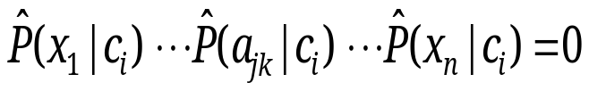
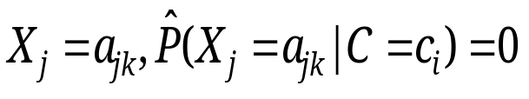
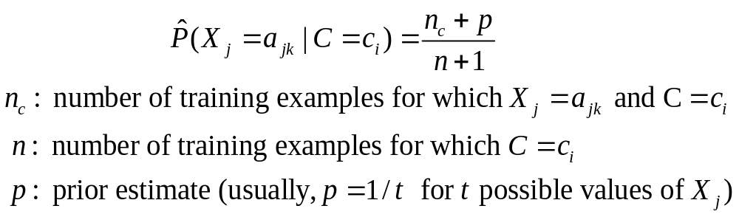
Issue -2
Zero conditional probability Problem
  Such problem exists when no example contains the attribute value
  In this circumstance, during test
  For a remedy, conditional probabilities are estimated with

Slide 57
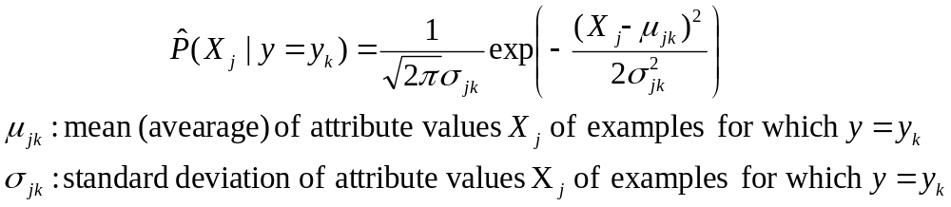
Continuous Features
What to do in such a case?
  Numberless values for an attribute
  Conditional probability is then modeled with the normal distribution
  Learning Phase:
  Output: normal distributions
  Test Phase:
    Calculate conditional probabilities with all the normal distributions
    Apply the MAP rule to make a decision

Slide 58
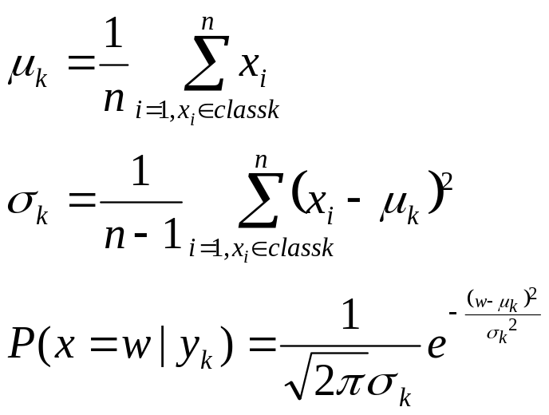
Continuous Features
Let x₁, x₂, …, x_{n} be the values of a numerical attribute in the training data set.

Slide 59
Classification measures
Confusion Matrix |  | Predicted Output
Actual Output |  | Positive | Negative
 | Positive | TP | FN
 | Negative | FP | TN

Slide 60
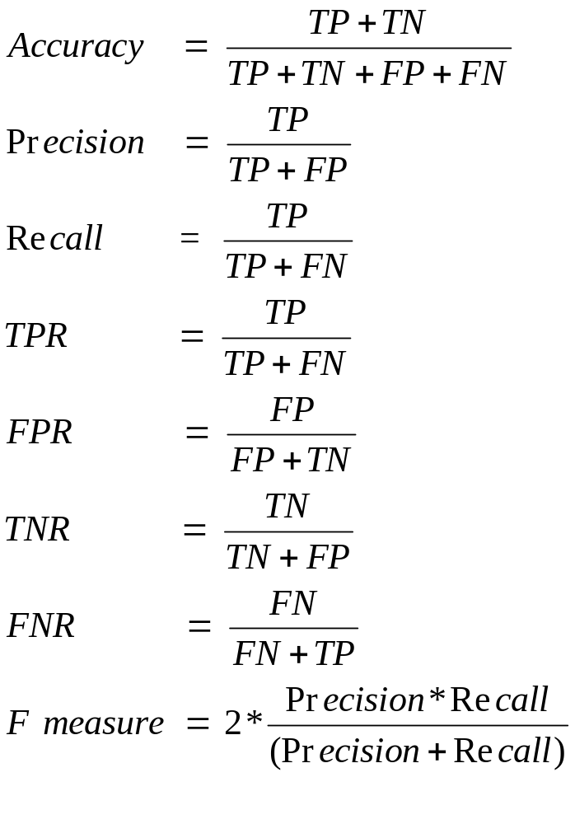
Performance Measures

Slide 61
Text classification
Sentiment analysis
Document classification
Radiology reports classification

Slide 62
Mammogram reports classification
Data collection
Data Preprocessing
Data visualization
Modeling
Evaluation

Slide 63
Actual data
Mammogram report
https://docs.google.com/document/d/1elwf75Rhv9iHCwiQ1WNy9U73YdhJlhlx/edit?usp=sharing&ouid=105663820335481814592&rtpof=true&sd=true

Slide 64
Preprocessing tasks
Lower case conversion
Tokenization
Stop words removal
Stemming / Lemmatization
Bag of words Generation

Slide 65
Mammogram reports data
Preprocessed Dataset
https://drive.google.com/file/d/1O1rA0T-fpTf_bEMpz1dUEYz-QYeNzCq-/view

Slide 66
Lower case conversion
parenchyma is predominantly fatty. no distinctly identifiable radio opaque mass. no parenchymal calcification. vascular pattern appears. normal pectoralis and retromammary space appear. normal nipple-areolar outline, skin & subcutaneous. fat plane are normal. no skin thickening or irregularity. left axillary lymphnodes seen normal. no mass / cyst left axillary lymphadenopathy with preserved fatty hilum

Slide 67
Punctuation removal
parenchyma is predominantly fatty no distinctly identifiable radio opaque mass no parenchymal calcification vascular pattern appears normal pectoralis and retromammary space appear normal nipple areolar outline skin subcutaneous fat plane are normal no skin thickening or irregularity left axillary lymphnodes seen normal no mass cyst left axillary lymphadenopathy with preserved fatty hilum

Slide 68
Tokenization
parenchyma is predominantly fatty no distinctly identifiable radio opaque mass no parenchymal calcification vascular pattern appears normal pectoralis and retromammary space appear normal nipple areolar outline skin subcutaneous fat plane are normal no skin thickening or irregularity left axillary lymphnodes seen normal no mass cyst left axillary lymphadenopathy with preserved fatty hilum

Slide 69
Stopwords removal
parenchyma is predominantly fatty no distinctly identifiable radio opaque mass no parenchymal calcification vascular pattern appears normal pectoralis and retromammary space appear normal nipple areolar outline skin subcutaneous fat plane are normal no skin thickening or irregularity left axillary lymphnodes seen normal no mass cyst left axillary lymphadenopathy with preserved fatty hilum

Slide 70
Stemming
parenchyma predominantly fatty no distinctly identifiable radio opaque mass no parenchymal calcification vascular pattern appears normal pectoralis and retromammary space appear normal nipple areolar outline skin subcutaneous fat plane normal no skin thickening or irregularity left axillary lymphnodes seen normal no mass cyst left axillary lymphadenopathy preserved fatty hilum

Slide 71
Preprocessed data
parenchyma predominantly fat no distinctly identifiable radio opaque mass no parenchyma calcification vascular pattern appear normal pectoralis and retromammary space appear normal nipple areolar outline skin subcutaneous fat plane normal no skin thickening or irregularity left axillary lymphnodes seen normal no mass cyst left axillary lymphadenopathy preserved fat hilum

Slide 72
Bag of words
{'soft': 177, 'tissue': 197, 'mass': 106, 'lesion': 93, 'mm': 114, 'spiculated': 182, 'margin': 105, 'note': 128, 'subareolar': 184, 'region': 157, 'clock': 22, 'position': 149, 'mild': 112, 'nipple': 120, 'retraction': 159, 'parenchyma': 140, 'predominantly': 151, 'distinctly': 39, 'identifiable': 70, 'radio': 155, 'opaque': 131, 'parenchymal': 141, 'pattern': 142, 'appear': 4, 'retromammary': 160, 'space': 179, 'outline': 136, 'skin': 175, 'subcutaneous': 186, 'fat': 54, 'plane': 145, 'thickening': 194, 'axillary': 9, 'lymphnodes': 102, 'lymphadenopathy': 100, 'preserved': 152, 'fatty': 55, 'hilum': 67, 'glandular': 66, 'calcification': 16, 'vascular': 203, 'normal': 127, 'pectoralis': 143, 'irregularity': 87, 'enlargement': 51, 'see': 165, 'bilateral': 12, 'ductal': 45, 'dilatation': 36, 'either': 49, 'side': 171, 'small': 176, 'fibroadenoma': 59, 'measure': 107, 'right': 161, 'breast': 15, 'subcentimeter': 185, 'nodular': 123, 'shadow': 168, 'scatter': 164, 'non': 125, 'specific': 180, 'well': 207, 'define': 32, 'radiopaque': 156, 'superior': 189, 'out': 134, 'quadrant': 154, 'mixed': 113, 'upper': 200, 'outer': 135, 'left': 92, 'evidence': 53, 'cyst': 29, 'leave': 91, 'obvious': 129, 'focal': 63, 'solid': 178, 'cystic': 30, 'alter': 2, 'echotecture': 47, 'simple': 173, 'tiny': 196, 'nodule': 124, 'within': 208, 'lipoma': 95, 'birads': 13, 'ii': 71, 'usg': 201, 'correlation': 28, 'do': 42, 'otherwise': 133, 'lymphnode': 101, 'vary': 202, 'size': 174, 'large': 89, 'one': 130, 'lymph': 98, 'node': 122, 'benign': 11, 'multiple': 116, 'complex': 26, 'internal': 81, 'component': 27, 'fibrocystic': 61, 'disease': 38, 'macro': 103, 'hypoechoic': 69, 'near': 118, 'areolar': 7, 'speck': 181, 'enlarge': 50, 'suggestive': 188, 'dense': 35, 'round': 162, 'defined': 33, 'show': 170, 'thick': 191, 'wall': 206, 'debris': 31, 'intramammary': 83, 'iii': 72, 'lobulated': 96, 'operative': 132, 'change': 19, 'area': 6, 'necrosis': 119, 'doppler': 43, 'study': 183, 'increase': 74, 'vascularity': 204, 'lymphadenopath': 99, 'pleft': 146, 'feature': 58, 'favor': 56, 'nonspecific': 126, 'infected': 76, 'dilate': 37, 'duct': 44, 'intra': 82, 'polypoid': 147, 'palpable': 139, 'oval': 137, 'shape': 169, 'macrocalcifications': 104, 'involuting': 84, 'braest': 14, 'iv': 88, 'benigh': 10, 'punctate': 153, 'inferior': 77, 'axilary': 8, 'medial': 108, 'two': 198, 'inner': 80, 'inflammation': 78, 'three': 195, 'respectively': 158, 'post': 150, 'another': 3, 'irregular': 86, 'septation': 167, 'layer': 90, 'cm': 24, 'volume': 205, 'cc': 18, 'infect': 75, 'periareolar': 144, 'favour': 57, 'huge': 68, 'involve': 85, 'entire': 52, 'degeneration': 34, 'significant': 172, 'abnormality': 0, 'echogenic': 46, 'focus': 64, 'cluster': 23, 'micro': 110, 'ill': 73, 'microcalcifications': 111, 'subtle': 187, 'adjacent': 1, 'rounded': 163, 'low': 97, 'fibroadenomas': 60, 'nocular': 121, 'ectasia': 48, 'thickened': 193, 'fluid': 62, 'surround': 190, 'architectural': 5, 'distortion': 40, 'likely': 94, 'galactocele': 65, 'distribute': 41, 'multifocal': 115, 'collection': 25, 'inflammatory': 79, 'thicken': 192, 'overlie': 138, 'poorly': 148, 'circumscribe': 21, 'seenwith': 166, 'underlie': 199, 'chest': 20, 'muscle': 117, 'metastatic': 109, 'calcified': 17}

Slide 73
Word to Vector Representations
Term frequency
tf(t,d) = count of t in d / number of words in d
Inverse document frequency
idf(t) = log (N / (df+1)
TF-IDF
tf-idf(t, d) = tf(t, d) * idf(t)
Continuous Bag of words
Skipgram
etc.

Slide 74
Dataset formulation
(doc-id, word index) tf-idf
(0, 4) 0.1002825695112369 (0, 9) 0.10311443634687989 (0, 15) 0.1401505563772833 (0, 16) 0.13874519001911678 (0, 32) 0.22291520954061128 (0, 49) 0.1187690095998007 (0, 51) 0.07224803580055394 (0, 54) 0.05108052826081885 (0, 66) 0.0922262945163657 (0, 87) 0.0653620172041886 (0, 100) 0.07151266840260619 (0, 102) 0.06472536003347226 (0, 105) 0.22636506223702832 (0, 127) 0.19608605161256581 (0, 134) 0.31154424546901305 (0, 136) 0.051557218173439945 (0, 140) 0.053513381886414954 (0, 141) 0.13464985646328953 (0, 142) 0.05060858161007134 (0, 143) 0.0653620172041886 (0, 145) 0.05108052826081885 (0, 151) 0.06600733664267906 (0, 154) 0.1679133405748244 (0, 156) 0.47325749186704136 (0, 160) 0.05060858161007134 (0, 161) 0.18673849468286002 (0, 165) 0.15467165452031983 (0, 168) 0.22636506223702832 (0, 171) 0.11145760477030564 (0, 175) 0.10121716322014268 (0, 176) 0.21637051165986626 (0, 179) 0.05060858161007134 (0, 182) 0.2336656246280111 (0, 186) 0.05108052826081885 (0, 189) 0.2760006397074813 (0, 194) 0.05060858161007134 (0, 203) 0.0653620172041886 (0, 207) 0.2132600528644208

Slide 75
Conclusion
Naïve Bayes is based on the independence assumption
  Training is very easy and fast; just requiring considering each attribute in each class separately
  Test is straightforward; just looking up tables or calculating conditional probabilities with normal distributions
Naïve Bayes is a popular generative classifier model
  Performance of naïve Bayes is competitive to most of state-of-the-art classifiers even if in presence of violating the independence assumption
  It has many successful applications, e.g., spam mail filtering
  A good candidate of a base learner in ensemble learning
  Apart from classification, naïve Bayes can do more…

Slide 76
Thank You!!
Queries???

